Slide 1
NIHSS National Institutes of Health Stroke Scale 美國國家衛生研究院腦中風量表
中榮神經內科
2013.05.11

Slide 2
Introduction
Originally designed as a research tool to measure baseline data on patients in acute stroke clinical trials
15-item scoring system
Integrating components of neurologic examinations:
LOC, select cranial nerves, motor, sensory, cerebellar function, language, inattention (neglect)
Ratings for each item have 3~5 grades; 0 as normal
Maximum score: 42, minimum score: 0
Higher score, severe clinical condition
A single patient assessment requires less than 10 minutes to complete.

Slide 3
Usefulness of NIHSS
As a common language amongst health-care providers
Good interrater and intrarater agreement, especially if rater is neurologist
Enhanced reliability of examiner trained and certified
Could be estimated from medical record review
Stratify stroke severity and decision of thrombolysis
>25➔ very severe neurological impairment
15-24➔ severe
5-14➔ moderately severe
<5➔ mild
ICH after IV-rtPA
NIHSS<10: 3% ICH after thrombolysis
NIHSS>20: 17% ICH after thrombolysis
Thrombolysis indicated!!
(Brott et al, 1989)
(NINDS stroke study, Stroke 1997)

Slide 4
Usefulness of NIHSS
For follow-up:
improvement or deterioration
2-point or greater increase in NIHSS➔ stroke in evolution
For prognosis prediction
Baseline NIHSS strongly predicts outcome
Outcome by 7 days and 90 days
≥ 16➔ less than 20% chance of achieving exellent outcome, high probability of death or severe disability
≤ 6 ➔ good recovery
Predictor of hospital disposition based on initial NIHSS
<= 5 ➔ 80% stroke survivors discharged to home
6-13 ➔ inpatient rehabilitation
> 13 ➔ discharge to nursing facility
(Adams et al, Neurology 1999)
(Schlegal et al., Stroke 2003)

Slide 5
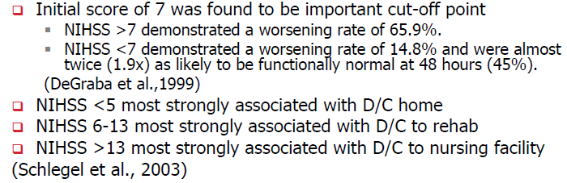
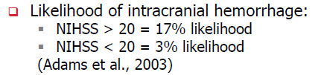
Nihss AND PATIENT OUTCOME

Slide 6
NIHSS Guiding Principles
The most reproducible response, accept for patient’s first effort (except for language~ for best performance)
Do not coach or cue the patients unless specified in the instructions
Some items are scored only if definitely present (ataxia, hemineglect)
Follow numerical order~ do not back and change the score
Score what you see, not what you think you should see.
Record all deficits in scoring, including those deficits that may result from previous strokes

Slide 7
計分說明
1.請依項目次序依序填寫(按步就班)
2.每個項目測試完立刻計分，請勿事後
再回頭更改分數(莫回頭)
3.請依照受測者之實際表現計分，而不
是施測者猜測受測者所能做到的程度
(眼見為實)
4.不要反覆教導受測者或重新嘗試，以
第一次表現計分(不強求)

Slide 8
1a Level of Consciousness 意識清楚程度
[Instruction]
Determined through interactions with the patient
Auditory stimulation (normal loud voice)
Tactile or deep pain stimulation
The investigator must choose a response if a full evaluation is prevented by such obstacles as ~ ETT, language barrier, orotracheal trauma/bandage.

Slide 9
1a Level of Consciousness
Scoring
0 = 清醒, 反應敏銳
1 = 不清醒, 但可藉由輕微的刺激喚醒而遵從指令,反應,或回答問題
2 =不清醒,需重複性刺激才能引起注意; 或意識遲鈍,需強大痛刺激才有非重複性的固定動作
3 =反應僅限於自主或運動神經的反射; 或對深痛刺激時完全無反應, 癱弛,甚至失去反射
Scoring
0 = Alert; keenly responsive
1 = Not alert, but arousable by minor stimulation to obey, answer or respond
2 = Not alert, requires repeated stimulation to attend; or is obtunded and requires strong or painful, noxious stimulation to make movements
3 = Responds only with reflex motor or autonomic effects or totally unresponsive, flaccid

Slide 10
1b Level of Consciousness 回答問題的意識程度
[Instruction] 問兩個問題
Ask the patient their age … wait for a response…
Ask the patient the current month …wait for a response…
Note:
Do not coach or give any verbal or non-verbal cues
Only record the initial answer
There is no partial credit for being close. (答案必須正確無誤,若相近則不算分; ex.問年紀, 回答生日)

Slide 11

1b Level of Consciousness
昏迷的病人（1a＝3）計2分
Scoring
0 = Answers both questions correctly
1 = Answers one question correctly
2 = Answers neither question correctly
Scoring
0 = 可正確回答兩個問題
1 = 可正確回答一個問題; 或因非失語症造成的語言障礙, 如: 氣內插管, 上呼吸道創傷,嚴重構音不全,語言障礙…
2 = 兩個問題皆無法正確回答;或失語症或木僵的病人
Patient unable to speak due to ETT, orotracheal trauma, severe dysarthria from any cause, language barrier, or any other problems not secondary to aphasia
Aphasic, stuporous, comatous (item 1a=3) patients who do not comprehend the question

Slide 12
1c Level of Consciousness 執行命令之意識程度
[Instruction] 做兩個動作
Ask patient:
- open & close your eyes
- grip and release the nonparetic hand
(若雙手無法使用,如:截肢或創傷,則以其他單一步驟指令取代)
Note
若病人對指令無反應，可以示範動作給他們看(pantomime)
→因此檢查是測試consciousness，非muscle power，所以不能以無力肢體的動作計分; 也非comprehension，所以可讓病人由模仿動作完成
若有熟遵照指令的嘗試性動作出現,但由於無力而無法完成整個動作,則仍算”有正確執行”
Score only the first attempt

Slide 13
1c Level of Consciousness
昏迷的病人（1a＝3）計2分
Scoring
0 = Performs both tasks correctly
1 = Performs one task correctly
2 = Performs neither task correctly
Scoring
0 = 可正確執行兩個命令
1 = 可正確執行一個命令
2 =兩個命令均不能正確執行

Slide 14
2. Best gaze 最佳的眼球運動
[Instruction] 僅測試眼睛的水平運動 (voluntary or reflexive)
Ask the patient to “follow my finger (tracking)” from side to side by moving the eyes only
Spontaneous eye movement (for aphasic or confused patients
Unconscious, trauma, pre-existing blindness patients: use oculocephalic maneuver (doll’s eye sign)
Tracking(VOR) : establishing eye contact and moving about the
patient from side to side and observing if the patient’s eyes follow

Slide 15
2. Best gaze
Scoring
0 = Normal horizontal eye movements
1 = Partial gaze palsy: abnormality in one or both eyes, but forced deviation is not present
2 = Tonic gaze deviation, or total gaze paresis (not overcome with oculocephalic maneuver)
Scoring
0 = 正常
1 = 部分凝視異常: 當雙或單眼眼球凝視異常，但並無強迫性偏移或完全癱瘓時 (可由反射性眼睛運動所矯正，或單一性周邊神經麻痺(第3, 4,或6對腦神經)）
2 =強直性的偏移,或完全癱瘓而無法用頭眼運動的反射矯正
- The patient has a conjugate deviation of the eyes that can be overcome by voluntary or reflexive activities (doll eye).
- The patient has an isolated peripheral nerve paresis (CN III, IV, VI)

Slide 16
3. Visual field 視野
[Instruction]
Test each eye independantly, upper and lower quadrants.
Confrontation test, by finger counting or visual threatening (for poor consciousness, aphasia, language barrier)
Note
若病患眼睛能適當注視動作中手指的方向，雖未直視檢視者眼睛，以正常計分
若單眼盲，用另眼的視野測試做計分。
若兩眼不一致，用較佳者計分。
可做順便做double simultaneous stimulation( for item 11)

Slide 17
3. Visual field
Scoring
0 = No visual loss
1 = Partial hemianopia (sector or quadrantanopia)
2 = Complete hemianopia
3 = Bilateral hemianopia (blind from any cause, including cortical blindness)
Scoring
0 = 無視覺喪失
1 = 部分偏盲
2 = 完全偏盲
3 = 兩側偏盲
- With clear-cut asymmetry
- Hemineglect by double simultaneous stimulation (even if field are intact by confrontation，因為當病人的hemineglect很嚴重的時候,其visual field可能會變得比較小

Slide 18
4. Facial palsy 顏面神經麻痹
昏迷的病人（1a＝3）計2分
[Instruction]
Ask the patient or use pantomime
-Show me your teeth (說”一”)➔ fewer teeth showing?
-Raise your eyebrows (皺眉頭)
-Close your eyes tightly (緊閉眼)
In the aphasic or confused patient: noxious stimulation
➔ Score symmetry of grimace (tickle each nasal passage one at a time using a cotton-tipped applicator and observe facial movement)
Note: If the facial trauma→ remove the bandage or other physical barrier that might obscure the face

Slide 19
4. Facial palsy
Scoring
0 = Normal symmetrical movement
1 = Minor paralysis: (i.e., flattened nasolabial fold, or mild asymmetry on smiling)
2 = Partial paralysis (total or near total paralysis of lower face)
3 = Complete paralysis of one or both sides (absence of facial movement in the upper and lower face)
Scoring
0 = 正常
1 = 輕微癱瘓(鼻唇間皺褶變平,微笑時不對稱)
2 =部分癱瘓(下半部的臉完全或幾乎癱瘓)
3=單側或雙側完全癱瘓(上和下半部的臉均無法運動)

Slide 20
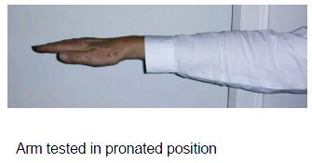
5. Motor: Arms (a: left arm, b: right arm) 運動系統: 上肢
昏迷的病人（1a＝3）計4分
[Instruction]
Place the limb in the appropriate position: Extend the arms (palms down)
- 45 degree as the patient is supine
- 90 degree as the patient is sitting up
Score the drift before full 10 seconds

Slide 21
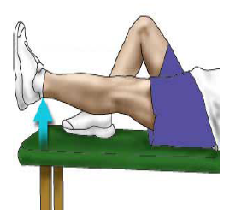
6. Motor: Legs (a: left leg, b: right leg) 運動系統: 下肢
[Instruction]
Place the limb in the appropriate position: Always test the leg in the supine position
- extending the leg at 30 degree
Score the drift before full 5 seconds

Slide 22
Note
Begin count immediately at the release of the limbs
Score the drift before 10 seconds (or 5 sec )
Count down out loud and with fingers in the patient’s view ➔ verbal + visual input
Encouraged using urgency in the voice & pantomine for aphasic patients
Begin from the non-paretic limbs
Do not test both arms simultaneously
Noxious stimulation was not allowed
UN(untestable or use the score “9” ): only in the amputation or joint fusion

Slide 23

5. Motor: Arms & 6. Legs
Scoring
0 = No drift and remain the position for the full 10 (5) seconds after any initial dip
1 = Drift ( the arm jerks or drop to the intermediate position without encountering the support, such as the bed before full 10 (5) seconds)
2 = Some effort against gravity (but the arm/leg can not get to or maintain the proper position, drift down to some support)
Scoring
0 = 無下垂,可維持90(或45)度完整10 (5) 秒鐘
1 = 晃動,肢體可維持90(或45; 30)度,但在10(5)秒鐘內會下垂,但不會撞到床上或其他支持物
2 =可稍抗重力,肢體不能達到或維持(給予暗示)90(或45;30)度,會下垂至床上,但仍有些許抗重力的力量
Muscle power: 3

Slide 24
5. Motor: Arms & 6. Legs
Scoring
3 = No efforts against the gravity
- the arm falls; but could “shrug the shoulders”
- the leg falls; but could flex the hip or adduct/abduct the foot
4 = No movement (unable to make any voluntary movements; or if Ia item scored as “3”)
Scoring
3=無法抗拒重力,肢體落下
4= 無任何移動
Muscle power: 2
Muscle power: 0,1
To differentiate from score 3 to 4, must wait for seconds to observe the movement ➔ Any movements, including small proximal movement (shoulder shrug or hip flexion) ➔ score “3”

Slide 25
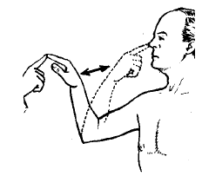
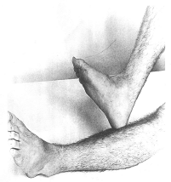
7. Limb ataxia 肢體運動失調
[Instruction]
Test all 4 limbs separately
Finger-Nose-Finger: ask patient to touch nose with finger, than touch examiner’s
Heel to Shin: ask patient to slide one heel down shin of the opposite leg
Note
Ataxia is only scored if present
Test with eyes open
Visual field defect→ perform the task in the intact visual field
Blindness→ have the patient touch nose from extended arm position
UN (untestable): joint effusion, amputation

Slide 26
7. Limb ataxia
昏迷的病人（1a＝3）計0分
Scoring
0 = Absent ; normal coordination
The movement should be well-performed, smooth, accurate, without clumsy
Too weak or cannot obey (cannot understand or comatous status)
1 = Ataxia, dysmetria, or dyssynergia present in one limb
Out of proportion to weakness
2 = Present in two limbs (both arms, both legs, or an arm & and leg on the same side of the body
Scoring
0 = 無此現象
1 = 出現於一肢體
2 =出現於兩隻體

Slide 27
8. Sensory 感覺
[Instruction]
Use sharp object for pinprick
Compare pinprick in same location on both sides
Aphasic or stuporous patients→ using vigorous noxious stimuli, such as nail pressure→ record grimace or withdrawal
Note
Test as many body parts as needed (arm[not hand], leg, trunk) to accurately check for hemisensory loss

Slide 28
8. Sensory
昏迷的病人（1a＝3）計2分
Scoring
0 = Normal, no sensory loss
1 = Mild to moderate sensory loss; patient is aware of being touched but pinprick is less sharp/dull on the affected side
2 = Severe or total sensory loss; patient is not aware of being touched in the face, arm and leg
Scoring
0 = 正常
1 = 輕微致中等程度的感覺缺失
2 =嚴重或完全的感覺缺失
Brainstem stroke with bilateral sensory loss
Does not respond and quadriplegic
Comatous status (1a=3)

Slide 29
9. Best language 語言
昏迷的病人（1a＝3）計2分
[Instruction]
Ask patient to perform the following:
Describe what is happening in the attached picture (Spontaneous speech)
Name the objects on the attached card (Naming)
Read from the attached list of sentences (Reading)
Comprehension: Judged from responses to all of the commands in the preceding

Slide 30
Note
If visual loss prevents standard examination:
- Ask the patient to identify objects placed in the hand (Naming)
- Repeat the sentences what he heard (Repetition)
- Ask patient to produce speech by asking a question. (Spontaneous speech)
The exam is the exception for the rule of scoring the first impression.
➔ We encourage, but not coach to stimulate the patient’s best performance.
Patient can write answers (ex. Intubation…)
Must choose a score for the patient with stupor or limited cooperation (3 only if the patient is mute and follows no commands at all)

Slide 31
Name all the objects on the card

Slide 32
Read all the sentences from the attached list
You know how.
Down to earth.
I got home from work.
Near the table in the dining room.
They heard him speak on the radio last night.
你吃飯了嗎
請猜猜看，我是誰
再見，下星期三這裏見
星期六，我們約好要去逛街
大頭、大頭，下雨不愁，人家有傘、我有大頭

Slide 33
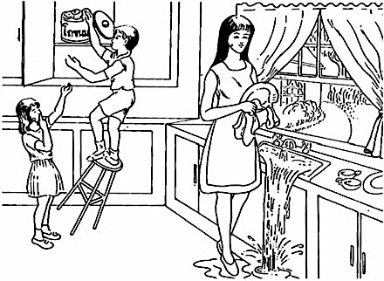
Describe “what is happening “in the picture

Slide 34
9. Best Language
昏迷的病人（1a＝3）計3分
Scoring
0 = No aphasia, normal fluency and comprehension
1 = Mild to moderate aphasia:
2 = Severe aphasia:
3 = Mute, global aphasia: no useable speech, no auditory comprehension. Patient unable to follow any one step commands.
Scoring
0 = 正常
1 = 輕微致中等程度的感覺缺失 (在表達上並無侷限性,檢測者仍可從病人的反應辨認其卡片或文字)
2 =嚴重或完全的感覺缺失(零碎及片段的溝通,檢測者需推論.詢問.及猜測病人的表達)
3 = 靜默,完全失語症 (無任何有用的語言或聲音的理解能力)
some obvious loss of fluency or comprehension, but no significant limitation on idea expression or form of production (able to “get their ideas across”)
all the patient’s expression if fragmentary, communication limited, examiner can not identify the content from the patient’s response (must guess what the patient is trying to communicate)

Slide 35
10. Dysarthria 構音障礙
[Instruction]
An adequate sample of speech must be obtained by asking patient to read or repeat words from the attached list even if patient is thought to be normal
If the patient has aphasia, the clarity of articulation of spontaneous speech can be rated
Note
UN(untestable) = Intubated or other physical barrier

Slide 36
Read /Repeat the words from the attached list
爸爸媽媽
啦啦隊
踢踏舞
負負得正
絲絲入扣
可口可樂
MAMA
TIP-TOP
FIFTY-FIFTY
THANKS
HUCKLEBERRY
BASEBALL PLAYER

Slide 37
10. Dysarthria
昏迷的病人（1a＝3）計2分
Scoring
0 = Normal
1 = Mild to moderate dysarthria (patient slurs some words but can be understood)
2 = Severe dysarthria (patient’s speech is so slurred/unintelligible in the absence of or out of proportion to any dysphasia)
Scoring
0 = 正常
1 = 輕微致中等程度的感覺缺失
2 =嚴重或完全的感覺缺失
- mute
- coma (item 1a=3)

Slide 38
11: Extinction & Inattention (Neglect) 半側忽略
Sufficient information to identify neglect may be obtained during prior testing.
If the patient has a severe visual loss preventing visual double simultaneous stimulation, and the cutaneous stimuli are normal, the score is normal.
If the patient has aphasia but does appear to attend to both sides, the score is normal.
The presence of visual spatial neglect or anosognosia may also be taken as evidence of abnormality.
Since the abnormality is scored only if present, the item is never untestable.

Slide 39
11. Hemineglect
昏迷的病人（1a＝3）計2分
Scoring
0 = No abnormality
1 = Visual, tactile, auditory, spatial, or personal inattention or extinction to bilateral simultaneous stimulation in one of the sensory modalities.
2 = Profound hemi-inattention or hemi-inattention to more than one modality. Does not recognize own hand or orients to only one side of space.
Scoring
0 = 正常
1 = 輕微致中等程度的感覺缺失
2 =嚴重或完全的感覺缺失

Slide 40
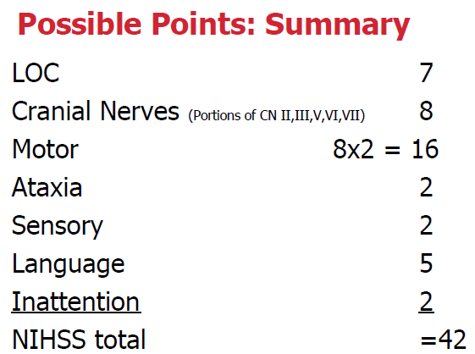

Slide 41
The score of deep Coma (item 1a=3)
1a=3 , 1b=2, 1c=2
2= (Max: 3)
3= (Max: 2-3)
4=3
5a=4, 5b=4
6a=4, 6b=4
7=0
8=2
9=3
10= (with ETT) UN; (without ETT) 2
11= 0
➔ Total: with ETT: 36+UN ; without ETT: 38

Slide 42
Limitations
眼見為憑~~可能會高估此次急性中風的結果
- 反覆性中風者 (分數可能包括前一次的 sequla)
- 失智症者 (認知,語言)
- Bell’s palsy
Language barrier, different cultural background

Slide 43
Thanks for your attention!!

Slide 44
Case
Normal
http://www.youtube.com/watch?v=wzjWAJgGjTw
Test:
http://www.youtube.com/watch?v=4hnz2iiCAgg

Slide 45
http://www.youtube.com/watch?v=gzHuNvDhVwE
http://www.nihstrokescale.org/

